Slide 1
Knowledge checks

Slide 2

True or False?
Digital documents will result in a change in the current way of working in P2 system
Notes:
Finalized
Released
TECO (correct)
Processing

Slide 3

Which Quality reports can be generated from P2 system?
Notes:
Finalized
Released
TECO (correct)
Processing

Slide 4

Select the criteria required for the CoA to be generated in QDA.
Notes:
Finalized
Released
TECO (correct)
Processing

Slide 5

True or False?
Bilingual CoA templates in QDA allow for the document to be generated in two languages at the same time
Notes:
Finalized
Released
TECO (correct)
Processing

Slide 6

True or False?
When uploading the same document in two different languages, the system will treat the uploaded documents as two separate entities keeping both documents active.
Notes:
Finalized
Released
TECO (correct)
Processing

Slide 7

True or False?
Customers will only be shown active documents through e-Business
Notes:
Finalized
Released
TECO (correct)
Processing

Slide 8

For the Certificate of Conformity to be automatically generated in ProdEtiq, what status must the Production Order be set to?
Notes:
Finalized
Released
TECO (correct)
Processing

Slide 9

When a Certificate of Conformity template is duplicated in ProdEtiq, only three areas of the document should be modified. Select the correct answers.
Notes:
Finalized
Released
TECO (correct)
Processing

Slide 10

Which of the following document types can be uploaded in OTM?
Notes:
Finalized
Released
TECO (correct)
Processing

Slide 11

True or False?
Documents are uploaded on an Order level in OTM.
Notes:
Finalized
Released
TECO (correct)
Processing

Slide 12
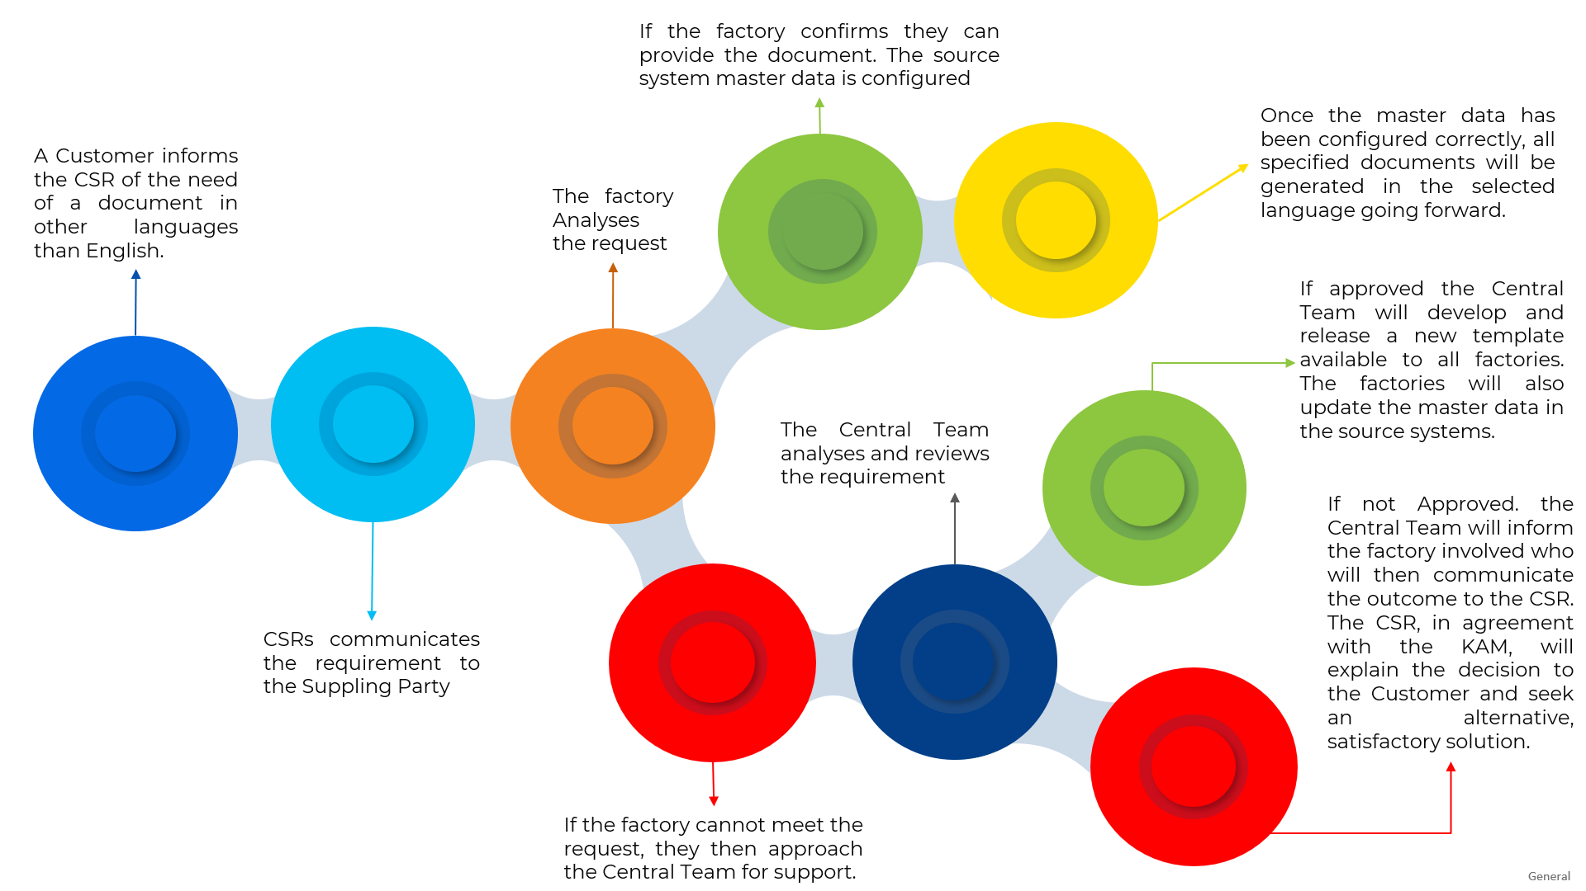
True or False? This is the correct process to follow when a customer requests a document in a different language?
Notes:
True.

